Slide 1
Business Overview
e-Waste & Information Security SL

Slide 2
Introduction
Data security vital to protect existence of organizations and individuals
Volume of data stored on the disk drives growing rapidly
Environmental concerns related to disposal of WEEE
Supply of raw materials required to manufacture disk drives not meeting demand

Slide 3
Data destruction
Software overwriting
Not 100% secure, requires functional disk drive, does not address material recovery
Degaussing, Shredding / Chipping
Not 100% secure, does not address material recovery
Smelting
Requires transport to smelter
Chemical destruction using LiquiDATA technology
100% secure, performed on customer site, addresses material recovery

Slide 4
Customers
Organizations
Government
All uniform services (military, police, special units)
Other government offices managing classified data
Private sector
Banking & Insurance, Healthcare, Legal, IT service providers (data centres)
Other companies managing confidential data
Individuals

Slide 5
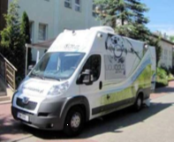
Our service
STEP 1 Arrival at customer site
Mobile Laboratory arrives and customer premises and prepares for operation.
Registration of media to be destroyed.
Note: Process starts from step 2. if media is sent by customer to e-WIS’s destruction centre.

Slide 6
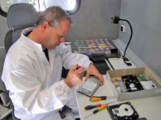
Our service
STEP 2 Preparation of data carriers
Disassembly of media to be destroyed and sorting of components.
Shredding of data platters.

Slide 7
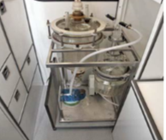
Our service
STEP 3 Dissolution of carriers
Perform first dissolution process (solution obtained can be used for waste water coagulation).
Perform second dissolution process (solution obtained can be used for wastewater treatment plant).

Slide 8
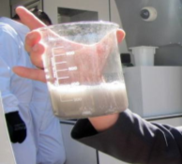
Our service
STEP 4 Completion of process
Prepare all fractions resulting from destruction for further disposal with appropriate recycling process.
Complete preparation of destruction certificates and any other supporting documentation.
Note: All of the activities within the Mobile Laboratory are monitored by CCTV and respective recordings can be provided.

Slide 9
Benefits
IRREVERSIBLE
Disk drives subjected to the process are dissolved into the liquid form thus removing any possibility of reconstructing of their initial structure
ECOLOGICAL
All of the products of the dissolution process can be used as ingredients of other chemical processes being used in a number of different industries ranging from pharmaceutical to waste treatment. All fractions created by disassembly of disk drives are recycled.
MOBILE & AUDITED
Destruction of disk drives can be performed at customer site by the Mobile Data Destruction Centre (MDDC). The MDDC provides customers with online access to the video and audio feed from cameras recording activities in and outside of the MDDC.
PROVEN
Chemical destruction of classified media and equipment is recommended by DoD 5220.22-M National Industrial Security Program for the highest security classified material. The LiquiDATA technology is the only commercial technology to meet the subject requirements.

Slide 10
Thank you
e-Waste & Information Security Management SL “e-WIS”
Via Augusta 15 – 25
08174 Sant Cugat del Valles
info@e-wis.es
www.e-wis.es

